Slide 1
Banking System
K.Likhit Chand:26
B.Sindhu:31
K.Prathyush:36
K.Sandesh:41
Ch.Sandeep:46

Slide 2
TOPICS
1.Requirement Analysis
2.Design Phase
3.Implementation
4.Testing & Verification
5.Result Analysis
6.Identify Limitations & Future Scalability

Slide 3
Requirements:
Hardware Requirements:
Ram:4Gb
Cpu: Both the JDK and JRE require at minimum a Pentium 2 266 MHz
processor
Memory :128 M Minimum Disk Space
Software Requirements:
Jdk 1.8
Platform: Windows (64-bit)
User Requirements:
Account Number
Account Password

Slide 4
DESIGN PHASE :
Start
LOG IN
Account Details
Cash Withdrawal
Cash
Deposit
Account to Account Transfer

Slide 5
User Name
Account ID
Enter Amount
Enter Deposit
Amount
Account+Amount
Output
If (Available)
Yes
No
Account-Amount
Print:No Balance

Slide 6
Enter Payees Account
If
(Payee Present in Database)
Member Not Present
No
Yes
Send Amount

Slide 7
Enter Payees Account
If
(Payee Present in Database)
Member Not Present
No
Yes
Send Amount

Slide 8
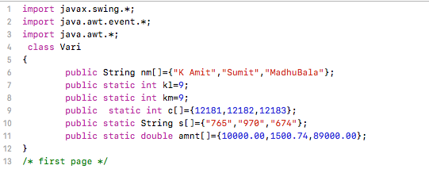

IMPLEMENTATION :
IMPLEMENATATION is very important phase where one has to properly the problem & code it using the Design phase
CODE :
This part of code contains initialization.
data which are which we are considering a different and related to them ,which will used throughout the program.

Slide 9
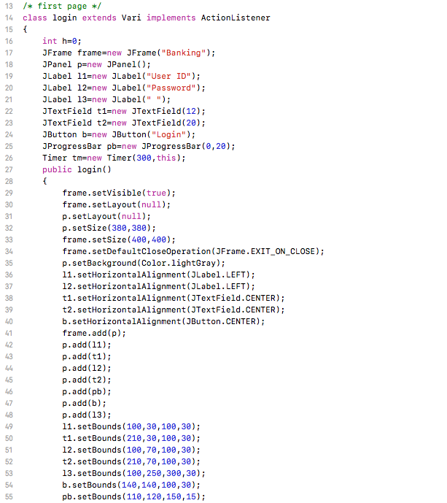
This the declaration of GUI Variables
which we are gonna use in our first page :
login page
so you can understand each frame will have different gui material and separate
code of it
Inside constructor login()
we are designing and placing GUI elements in a frame.
As it is constructor it is called when instance created

Slide 10
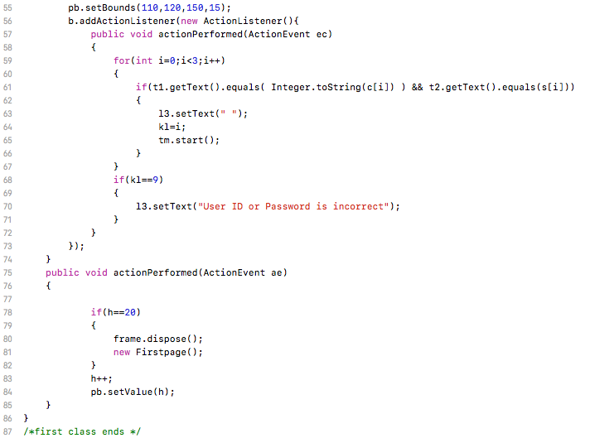
ACTIONLISTENER IS A INTERFACE .
AS WE CALLED IT USING THE OBJECT OF BUTTON SO WHENEVER BUTTON IS CLICKED ACTION PERFORMED FUNCTION IS CALLED AND EXECUTES STATEMENT IN IT.
getText() & setText() methods are getting or updating data in some GUI materials like labels,textfield.
login frame ends from here

Slide 11
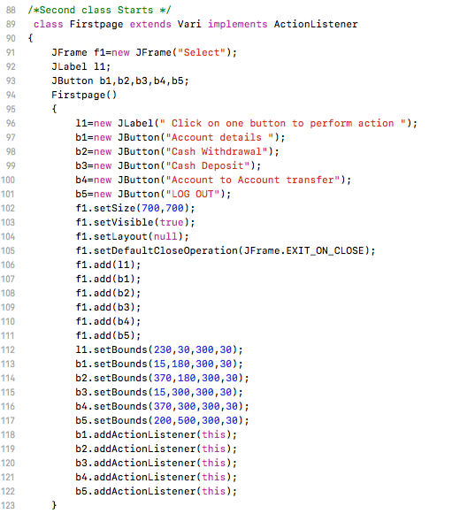
It is the second frame after a successfull login they will be entering this page .
Same as the first page it contains some GUI materials declaration and
constructor for frame designing .

Slide 12
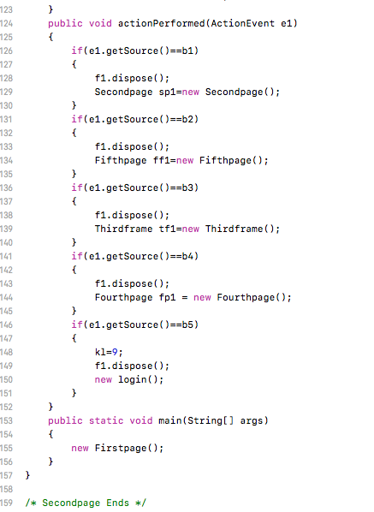
In the interface actionlistener()
getSource( ) is a method for getting using what the action is performed , like in this case it tells us which which button is clicked , then respective action will take place as different buttons have different functionalities.
and with this 2nd Frame end here

Slide 13
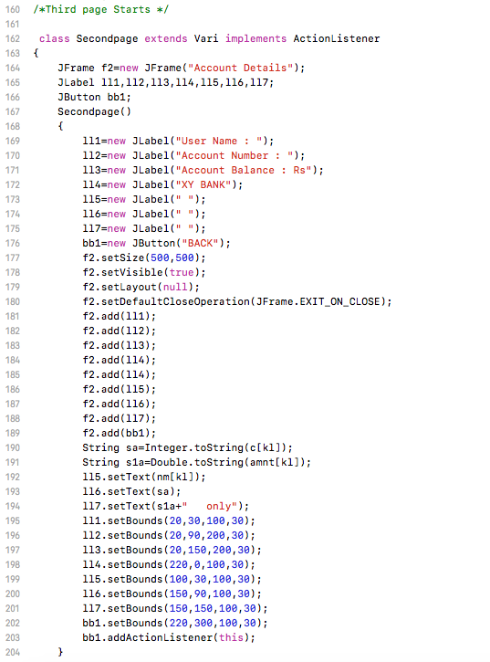
Its beginning of third frame , same as other frames gui materials placing , declaration …
and other stuff

Slide 14
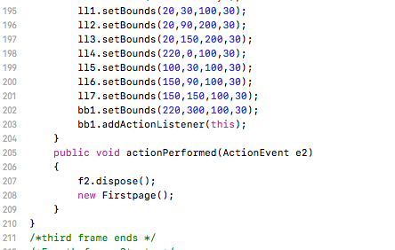
Main purpose of this frame is to show the user Details .
Third frame ends from here.

Slide 15
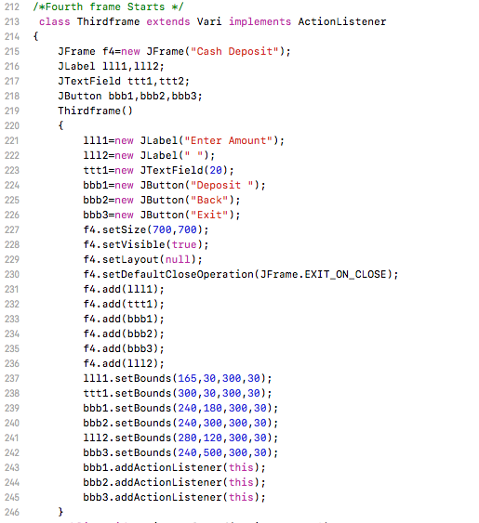
Its Fourth frame.
As it beginning of the frame it contains usual GUI material(i.e: button ,
text field, label, frame) declaration
and its arrangement.
Purpose of this page is :
for depositing money.

Slide 16
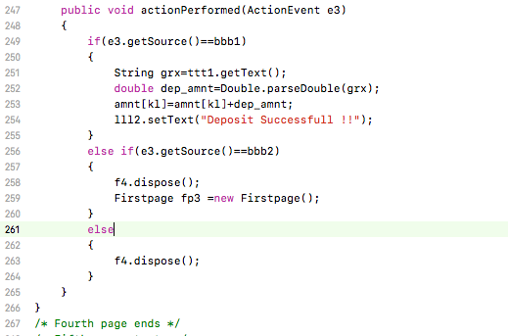
As it is deposit amount , so here we are getting data from textfield and converting to double type as by default textfield’s contains string type data.
Then we are adding that amount to our bank balance.
our fourth frame ends here .

Slide 17
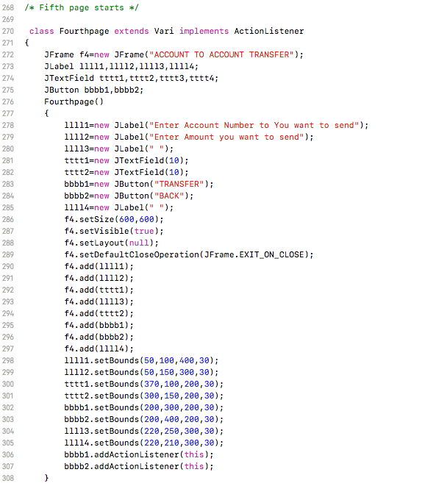
It is Fifth frame.
And the purpose this frame to
Transfer money from one account to another.

Slide 18
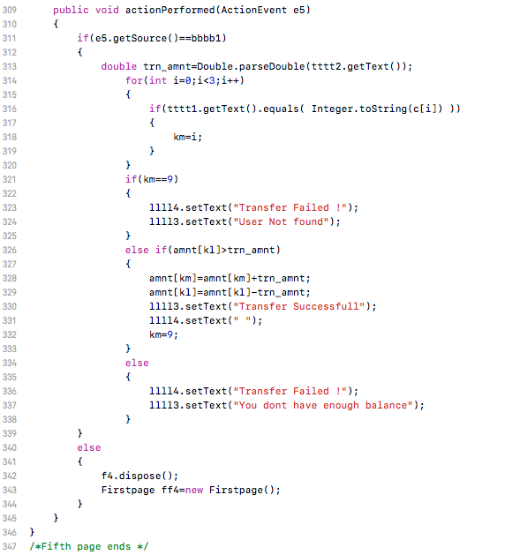
In this part we are getting input from textfield : whose account should you send and how much you will be sending.
once we find that account number in our data and sender has money greater than he wants , then money from sender’s account will be subtracted and send to the entered account number .
So ends our Fifth frame .

Slide 19
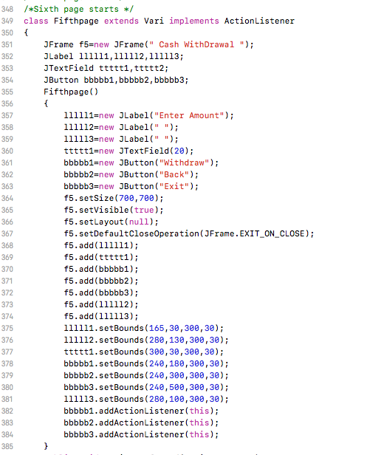
Its Sixth frame which is made for Cash Withdraw
from an account .

Slide 20
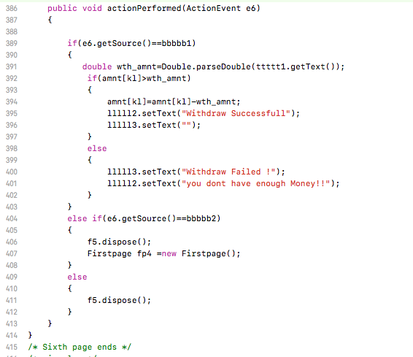
it is similar to deposit case but here we are reduced amount from login person and and giving him cash $$$ .
So here ends our last frame ...

Slide 21
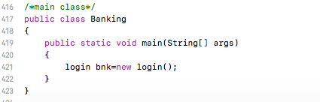
It's our main class from which we are gonna call our login class .
so whenever we are gonna execute the our program Login page will
appear first .

Slide 22
So before talking about other topics , you should get to know how to execute this program :
1)open our command prompt and move to the directory where you saved it using “ cd ” command .
2)type javac Banking.java in command prompt .
3) then type java Banking .
4) Then you will a java file opening .

Slide 23
Testing and verification :
After designing and implementing a solution for a problem next thing one should do is verifying whether its matching with the required result or not.
If it is not even near you expectation you should keep on modifying it .
If it matches requirement you should test it for different cases most likely one might find a bug or error which might effect your program in future .

Slide 24
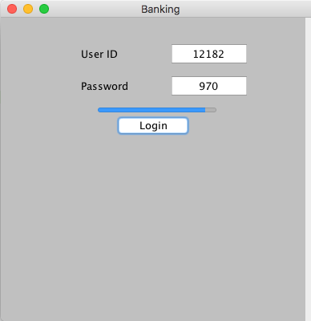
Its normal exection where you entered proper user id and password .

Slide 25
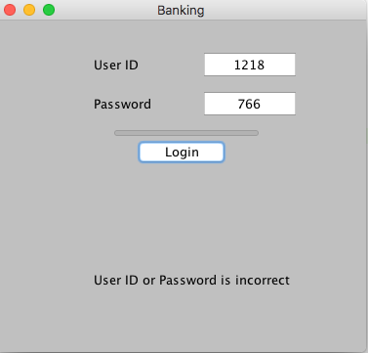
Its case where you entered incorrect user id and password .

Slide 26
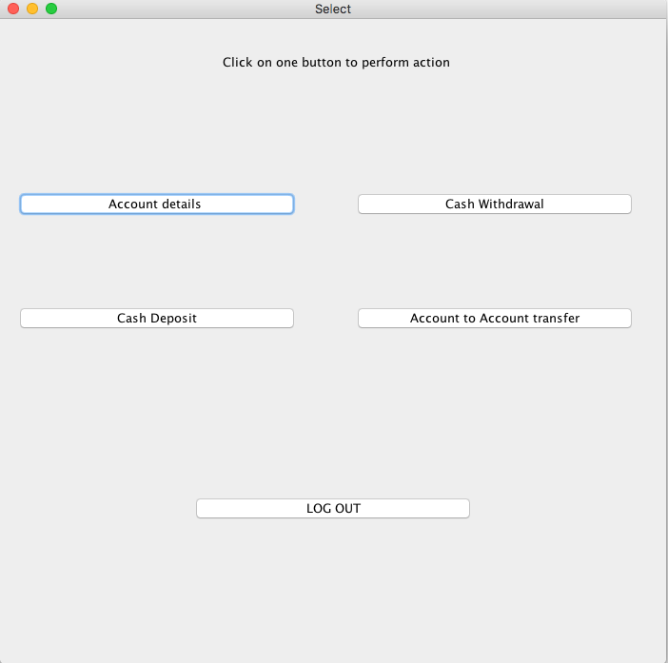
After you Successfully Login its what it looks like.
You have to select any of the Five buttons perform an action . Function of Different Buttons :
1) Account details : gives your account details
2)Cash Withdrawal : Withdraws money from your account .
3)Cash Deposit : Deposits cash to your account.
4)Account to Account Transfer : It transfers money from one account to another account.
5)Log out : you log out from current account.

Slide 27
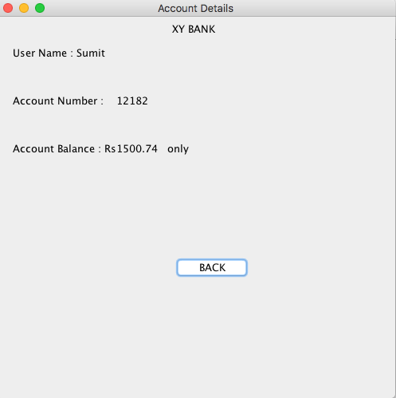
Its what it looks like when you press account details button .
And by pressing back button you can go back to pervious page(button selection ).

Slide 28
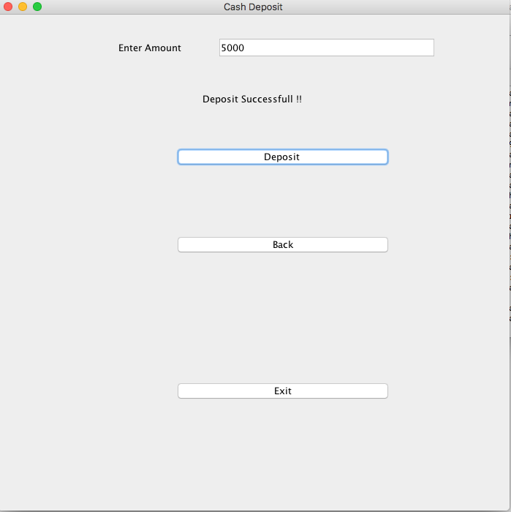
Its Deposit frame you can deposit money .
back button brings you back to the previous page(selection of buttons).
exit button closes the whole program.

Slide 29
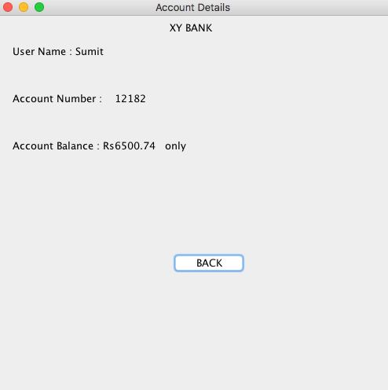
so we can see here our account balance is increased by Rs 5000 due to depositing.

Slide 30
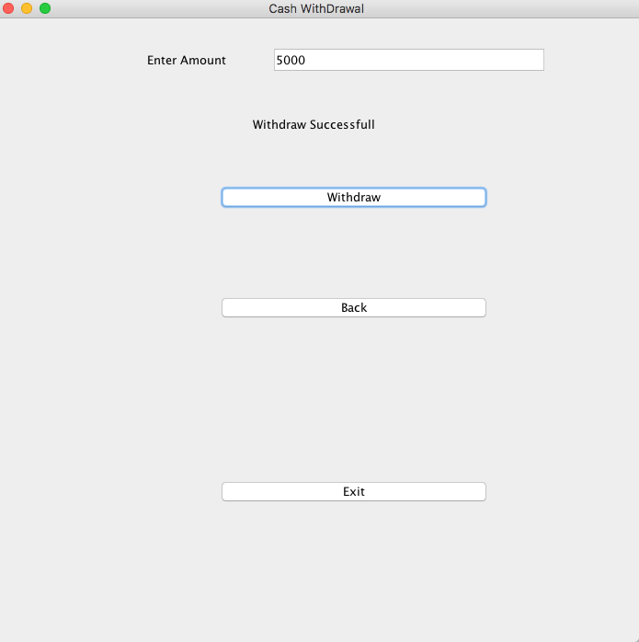
It is money withdraw section. where you can withdraw money from our account .

Slide 31
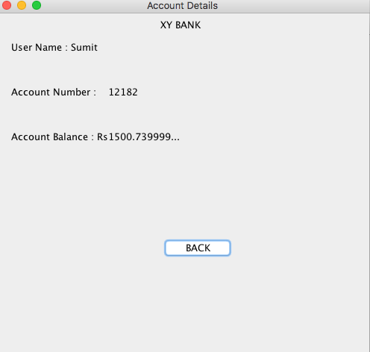
So we can see here in account detail section that Rs 5000
is taken out of my account .

Slide 32
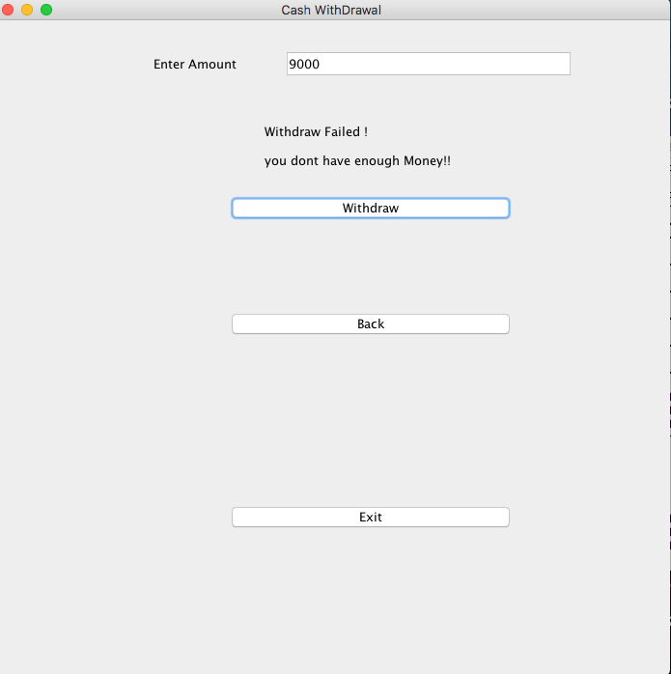
When you try to withdraw more money then you have in balance it what it looks like .

Slide 33
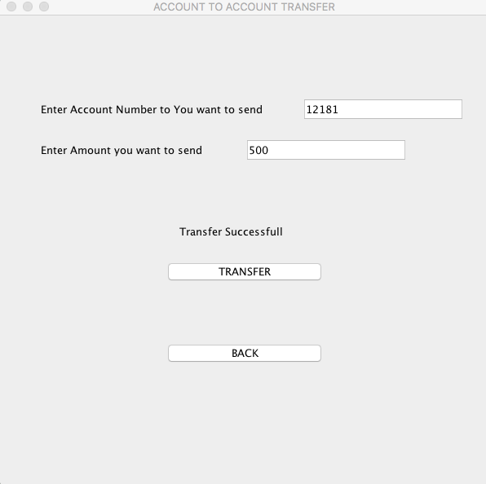
Its account to account transfer frame , where you can send money from one account to another account .
All you have to do is enter both the details (Account_number and amount ) correctly and click on transfer button , it will send the money .
And back buttons takes back to the previous frame.

Slide 34
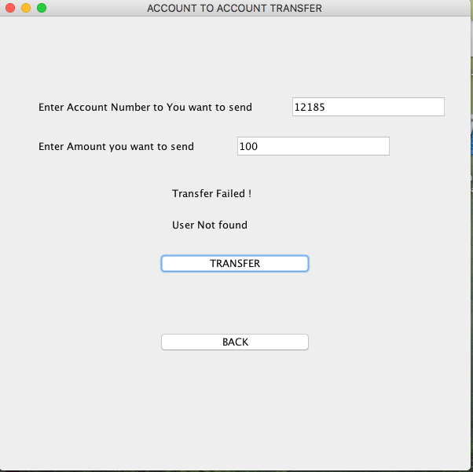
It's the case you entered the wrong the Account number.
As the user isn't present in our data
so it will show “user not found”.

Slide 35
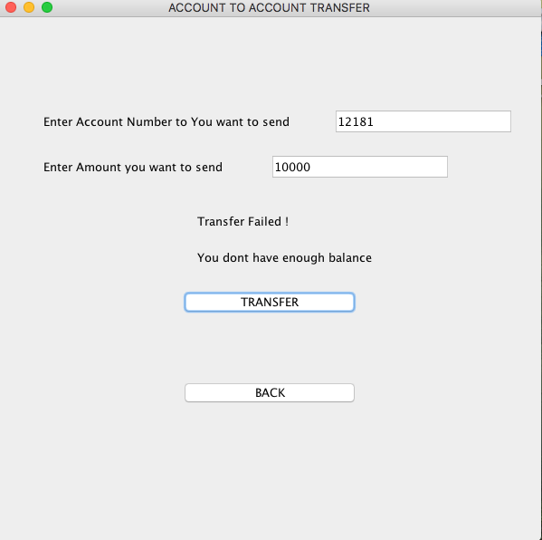
Its the case you entered the amount you want to transfer is greater than amount you have.
As you dont have enough money foto send it shows you dont have enough balance.

Slide 36
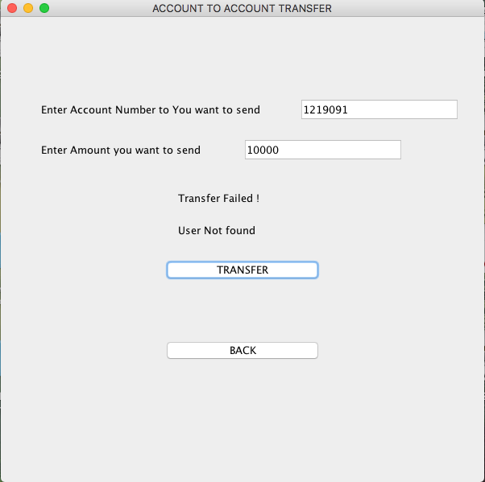
Its the case you entered both account number and amount wrong.
It first make you sure about account number then amount you want to send.

Slide 37
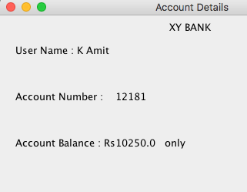
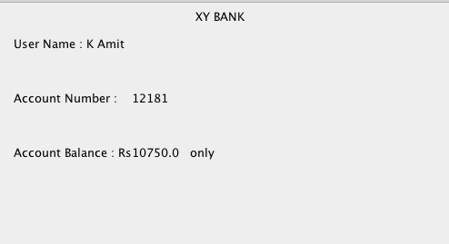
BEFORE TRANSFER :
So you people can see that sumit sent Rs 500 to Amits account.
We can see here increase of money by Rs 500 in Amits account .
Hence it works
{“for checking amits balance you have logout and login as amit closing the program and reopening may bring you trouble.”}
AFTER TRANSFER :

Slide 38
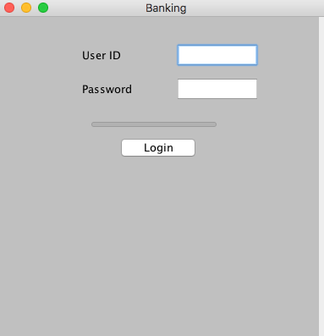
Its our last button output that is Logout button .
where you have to re enter the credentials for doing task.
With this verification of result is over as we tried every possibility.

Slide 39
Result Analysis :
From the above screenshots we can see that each & every functionality of the program is working perfectly. eg :
In Login page both the textfield takes integer data and compares them to fixed data if entered properly and clicked in login it will move you to selection page if it is incorrect it will show you error message.
After login you will be entering to operation selection page where each button has a separate purpose
Display Details : shows all your account info.
Deposit : adds money to our account .
Withdraw: Removes Money from your Account .
Account to Account Transfer : Transfer money from one account to another
Log out : it removes current user from functioning so that new user can perform his required activity.

Slide 40
In Deposit frame it double values. Amount of deposit has no limit here (Highest value which double can take is last).
In Withdraw frame we can withdraw money less than our account
balance if more than or equal amount present in account balance is taken out then it will be showing an error.
In account to account transfer one has to enter proper user id(integer) to transfer money and if you try to transfer more than or equal amount money you posses in our account it will show error and transfer will be failed, else it work and one can check that by logout and login by the account to which money is transferred .

Slide 41
Identify limitations & Future Scalability
Limitations :
1 ) Due to Lack of Knowledge of Database Concept for data storage ,usage and manipulation , we have to use predefined user data as a result we cannot add new data / user or remove an old data /user.
2) We had to use static variable for user data atleast to retain till program closes. As result whatever changes you do wont be saved if you close the java execution and reexecute it again the
values will set to default .

Slide 42
3) Due to lack of connectivity it cannot be used for Globalwide .
Scalability :
If we would be able add database to it we could make it more interactive and more relevant .
we can add connectivity can make it worldwide usable .

Slide 43


